Slide 1

2019 Employee Data Report
Phillip Hale
For additional details on the dataset and findings refer https://github.com/naivelogic/MSDS/tree/master/CaseStudy2

Slide 2


Overview
Top factors for employee attrition
Insights from predicting employee attrition
and potential correction indicators
Insights on employee salaries
and the corresponding impacts
Notes:
EMS Overview
© 2014 Microsoft Corporation. All rights reserved. Microsoft, Windows, Surface and other product names are or may be registered trademarks and/or trademarks in the U.S. and/or other countries. The information herein is for informational purposes only and represents the current view of Microsoft Corporation as of the date of this presentation. Because Microsoft must respond to changing market conditions, it should not be interpreted to be a commitment on the part of Microsoft, and Microsoft cannot guarantee the accuracy of any information provided after the date of this presentation. MICROSOFT MAKES NO WARRANTIES, EXPRESS, IMPLIED OR STATUTORY, AS TO THE INFORMATION IN THIS PRESENTATION.
8/18/2019
2

Slide 3


d
Data Set
Reviewed over
870
Employees
across
9
Job Role Types
in
3
Departments

Slide 4


MONTHLY INCOME BEST CORRELATED ATTRITION INDICATOR...
Top 5 employee attrition correlated indicators

Slide 5
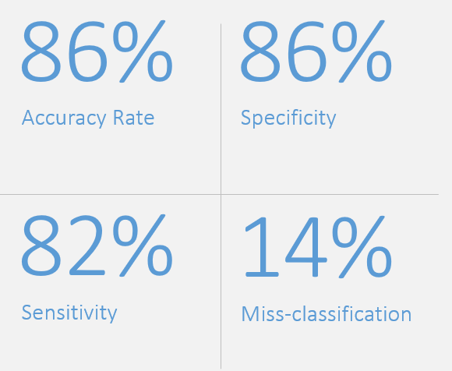
Employee Attribution Model
Results from employee attribution
prediction model

Slide 6
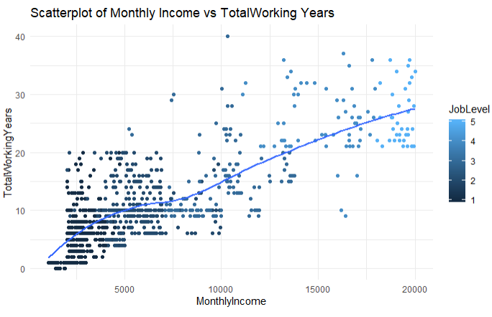

Slide 7

Results from Linear Regression Model
90%
$1,312
R-Squared
Root Mean Squared-Error
-1877
Predictor Variables:
Job Level
Job Role
Attrition
Total Working Yrs (Log)
Akaike information criterion (AIC)

Slide 8

Recap: 2019 Employee Report
Employee Attrition - key indicators for employee turnover were employees working overtime, lower Salary and a decrease in job involvement.
Monthly Income Prediction – JJob Role and Job Level were key to predicting salary
Age and Gender - with continued practice, Age and Gender were indicated to not be key factors in predicting Salary and Turnover.
2019 Employee Report – For more information please refer to https://github.com/naivelogic/MSDS/tree/master/CaseStudy2

Slide 9
OVERTIME WORKERS MOST
IMPORTANT ATTRITION INDICATOR...
Top 5 employee attrition indicators in the United States

